Slide 1
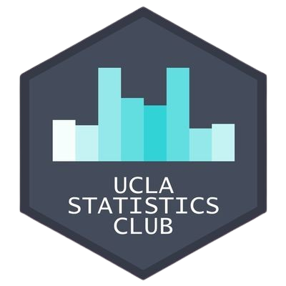
Intro to Python Workshop
Benjamin Yu & Reeshad Mohammed

Slide 2


About the Presenters
Reeshad
Mohammed
Benjamin Yu
Workshop Co-Chair
Data Theory Major
Workshop Co-Chair
Statistics & Applied Math Majors, Digital Humanities Minor

Slide 3
Table of Contents
01
Basic Data Types & Operators
Introduction to the fundamental data types of Python and how to work with them
02
Basic Data Structures
Different ways to store and operate on collections of data
03
Conditional Statements
Controlling flow of execution based on different conditions
04
Loops
Repeating segments of code for iterative tasks
05
Functions
Encapsulating segments of code into reusable commands

Slide 4
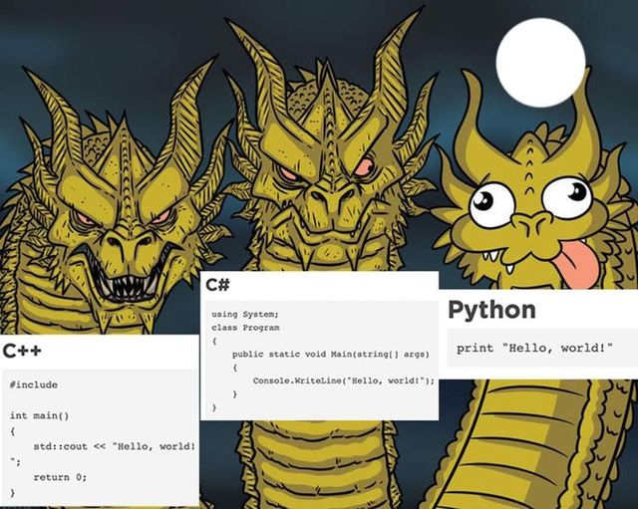
Introduction
Why Python?
Python is a general-purpose programming language. It is a very popular programming language due to its simplicity and beginner-friendly nature and its very many applications (AI/ML, Data Science, OOP, etc.)

Slide 5
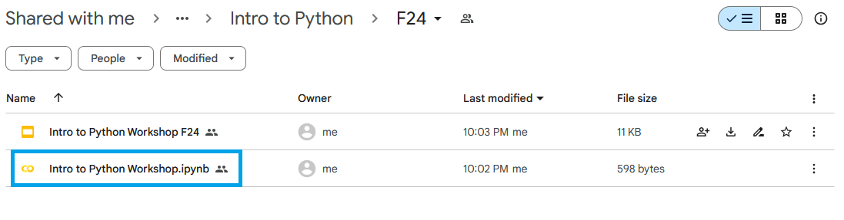
Instructions
Open Google Drive Link: https://tinyurl.com/IntroPythonF24
Click on “Intro to Python Workshop.ipynb”

Slide 6

Google Colab Basics
Web-based cloud platform allowing people to executing Python code in a Jupyter Notebook environment
Python code divided into cells
Ctrl + Enter: run current cell
Ctrl + M + A: insert cell above
Ctrl + M + B: insert cell below
Ctrl + M + D: delete current cell
Ctrl + M + Z: undo
Mac Users: Cmd instead of Ctrl

Slide 7
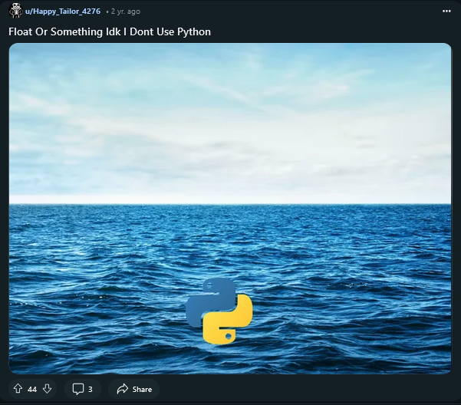
Data Types and
Operators
Building blocks of Python
There are four fundamental data types in Python, which are:
Integers (int)
Floats
Boolean (bool)
Strings (str)

Slide 8
Arithmetic Operators
Addition: (+)
Subtraction: (-)
Multiplication: (*)
Exponential: (**)
Division: (/)
Floor Division: (//)
Modulus: (%)

Slide 9
Comparison Operators
Equal: (==)
Not equal: (!=)
Less than: (<)
Greater than: (>)
Less than or equal to: (<=)
Greater than or equal to: (>=)

Slide 10
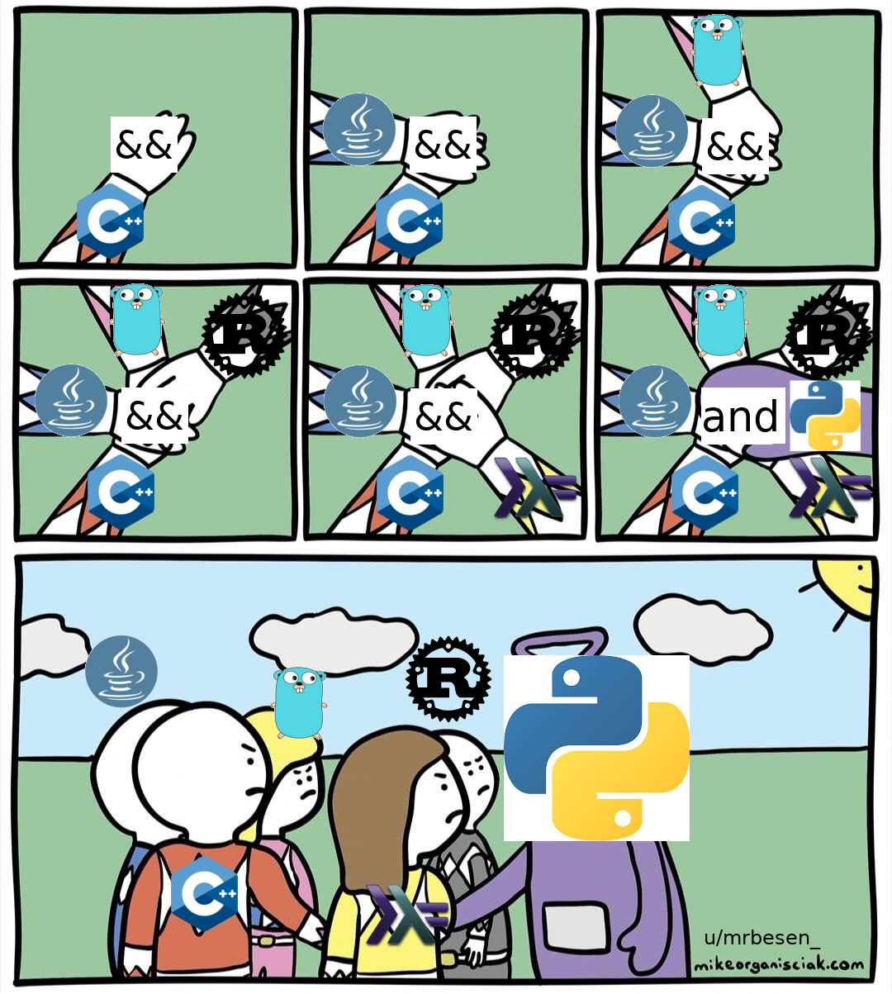
Boolean Operators
and
True if both statements are true
or
True if either statement is true
not
Negates previous statement

Slide 11

Boolean Operators

Slide 12
Exercise 1
Use Python to calculate the following equations. In the same cell, print the data type of the output.
35 + 27
26 * 13
40 / 5
Edit the following examples such that they return True
(2 >= 5) and (4 < 3)
(3 != 3) or (4 != 4)
not ((((5 == 5) or (8 > 2)) and not (7 < 3)) or ((9 == 9) and (4 > 12))) and (not ((14 <= 14) or (3 != 3) or (6 == 7))) and ((5 > 3) and not (7 > 9) or (10 <= 8))
Hint: it’s a lot easier than it looks!

Slide 13
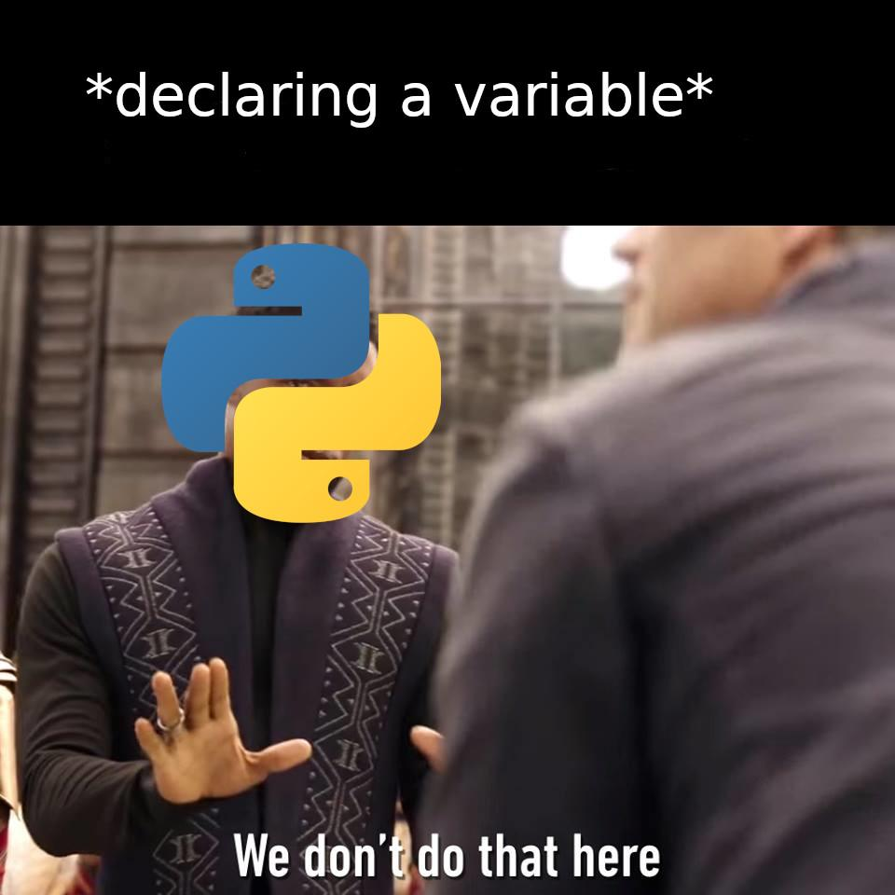
Variables
Declaring is overrated
Variables store data in computer memory. When declared, a place in memory is dedicated to the data, which the variable “points to”. Variables can store any type of data and make it easier to organize data in Python.

Slide 14
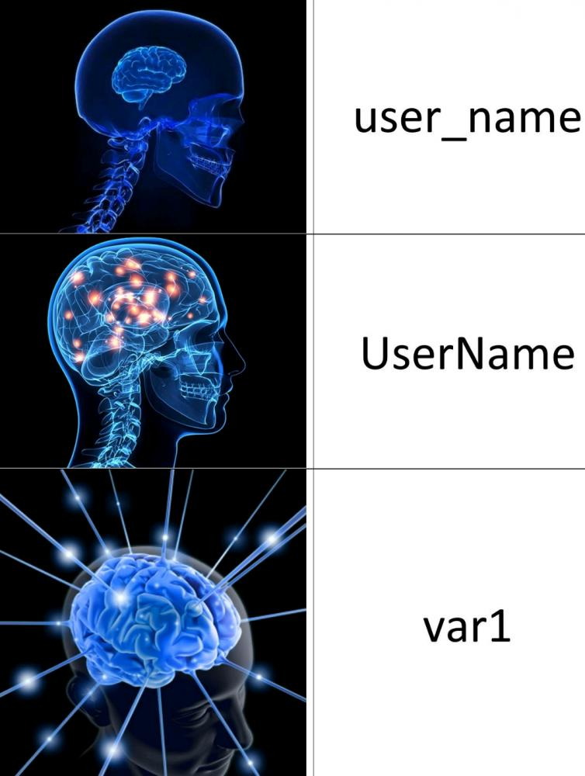
Variable Naming Conventions
Must start with letter (a-z, A-Z) or underscore
2. May not start with a number
3. May only contain alphanumeric values
4. Case-sensitive

Slide 15
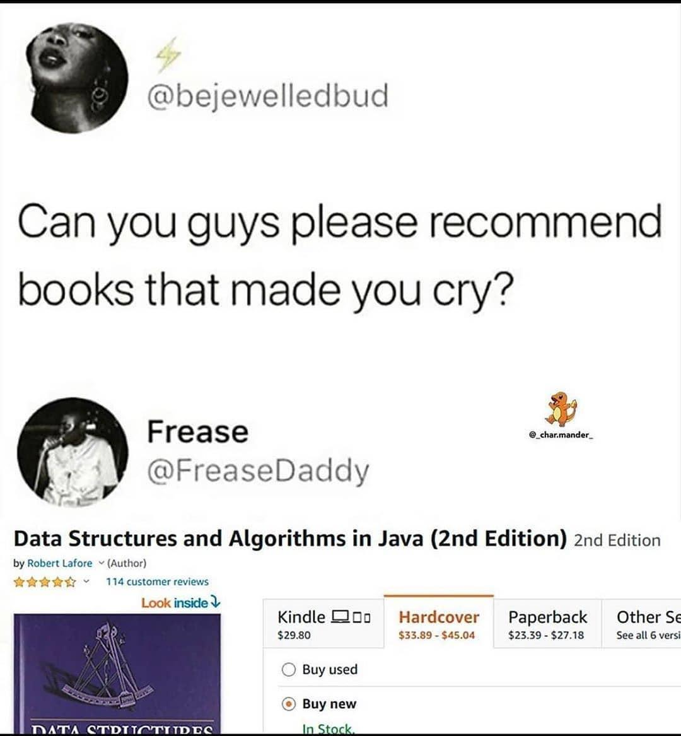
Data Structures
Lists in Disguise
Data structures are useful in storing data efficiently, allowing for us to easily access, update, and perform operations on them.

Slide 16
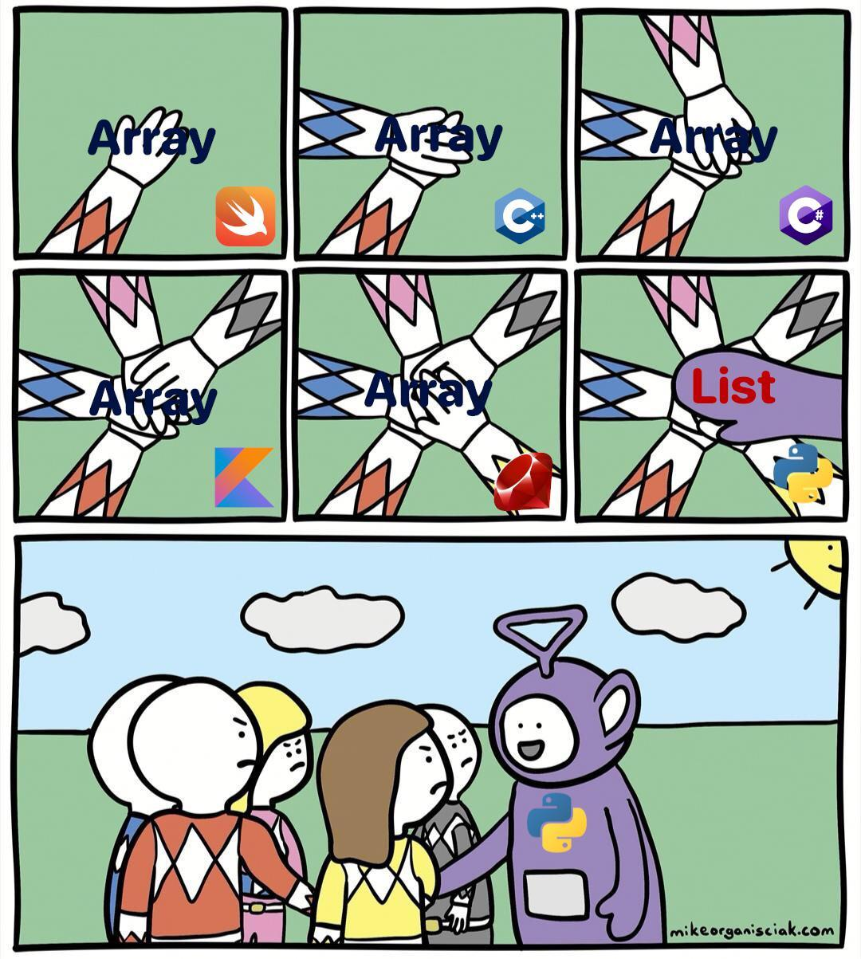
Lists
Can store any type of information
makes it easier to reuse and organize data in a program

Slide 17
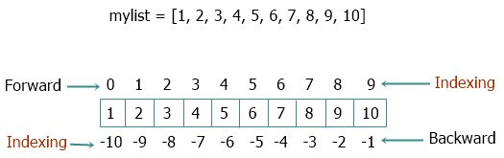
List Indexing
Access elements by taking the variable name and passing through the index number
Can also pass sequences of numbers and negative numbers as well

Slide 18
List Built-in Methods
append()
extend()
insert()
remove()
pop()
clear()
index()
count()
and many others…

Slide 19
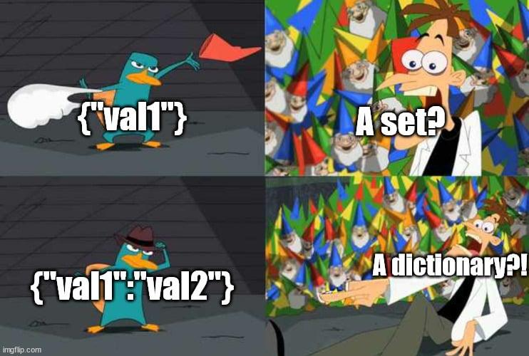
Dictionaries
Similar to lists, but map keys to values
Keys can only be immutable objects (i.e. they cannot be edited once initialized, like strings or tuples).

Slide 20
Dictionary Built-in Functions
get()
items()
keys()
values()
pop()
and many others…

Slide 21
Exercise 2
Given the following list:
Print the index of 12.5
Add the element "Maybe" to the list
Remove "apple" from the list
Print the 3rd to 7th elements of the list
Create a dictionary with the following key value pairs:
Name: your name
Year: your year
Favorite food: your favorite food
Favorite TV show: your favorite TV show
[42, "apple", 3.14, True, "Python", 67, "banana", False, 12.5, "elephant"]

Slide 22
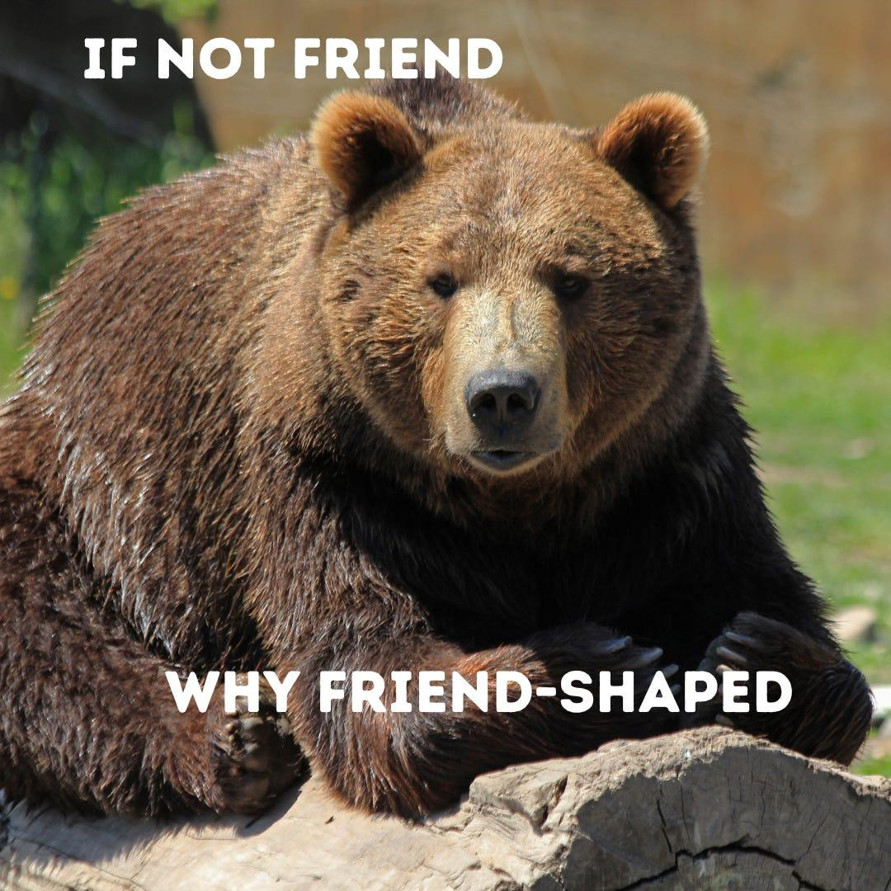
Conditional Statements
Justin Case
Conditional statements allow for us to implement various conditions into our code, so we could run different blocks of code depending on scenarios.

Slide 23
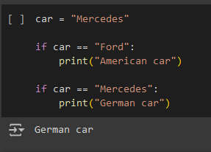
If Statements
If statements can structure condition based lines of code
Format:
if condition satisfied:
Do some task
Example:

Slide 24
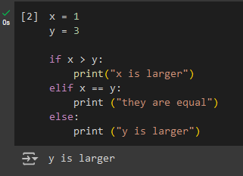
Elif and Else Statements
Elif and else add additional conditions to if statements
Format:
if condition satisfied:
Do some task
elif other condition:
Do some task
else:
Do some task
Example:

Slide 25
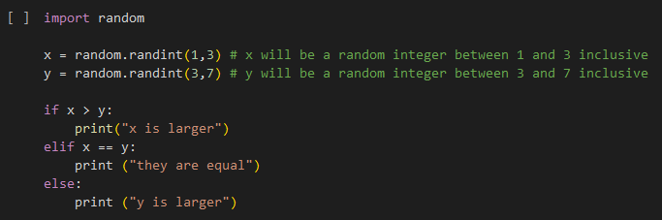
Exercise 3
The comments (parts after # in green) explain how x, y get assigned a value.
What are the possible outputs of this code?

Slide 26
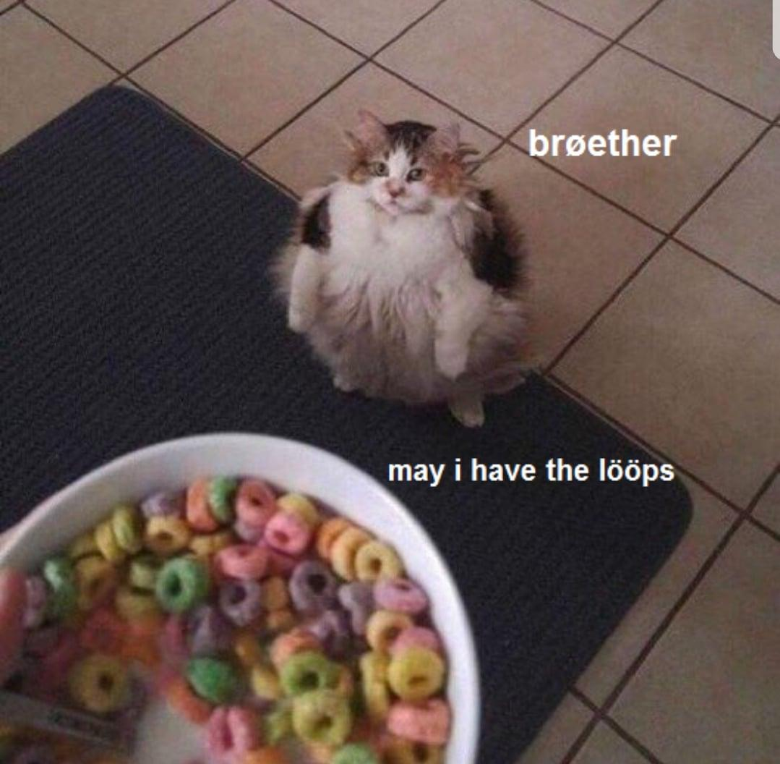
Loops
Cause once wasn’t enough
Loops allow for us to run segments of code several times in succession, reducing redundancy.

Slide 27
For Loops
Repeats a loop a set number of times
Loops through iterable objects (lists, strings, etc.) and does some action on it
Most common: range object
for var in interable:
do some task
Notes:
Add a bit more to this slide, so explaining is easier

Slide 28
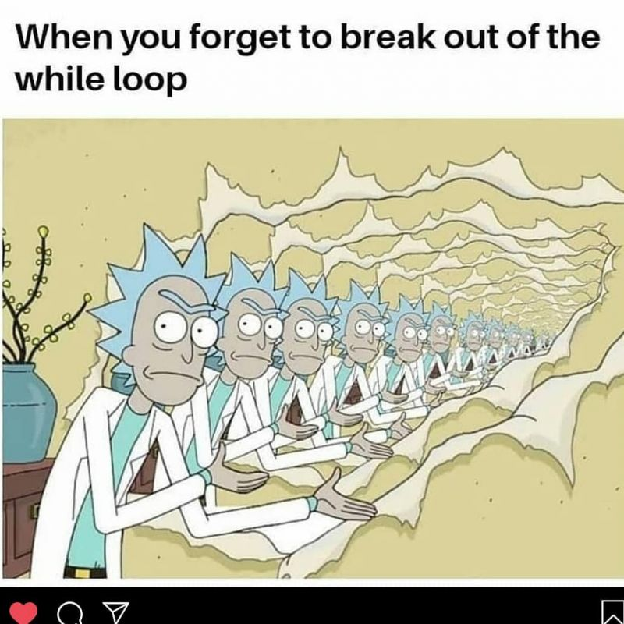
While Loops
Repeats loop continuously until some condition is satisfied
The update is important, so the loop does not repeat forever
while condition satisfied:
Do some task Update aspect of condition

Slide 29
Exercise 4
Write a short program that prints each number from 1 to 100 on a new line.
For each multiple of 3, print "Fizz" instead of the number.
For each multiple of 5, print "Buzz" instead of the number.
For numbers which are multiples of both 3 and 5, print "FizzBuzz" instead of the number.

Slide 30

Functions
Bottom Text
Functions in Python allow for us to bundle segments of code into callable commands, removing redundancy from programs

Slide 31
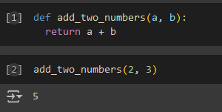
Functions
Format:
def function(arguments):
stuff
Example:

Slide 32
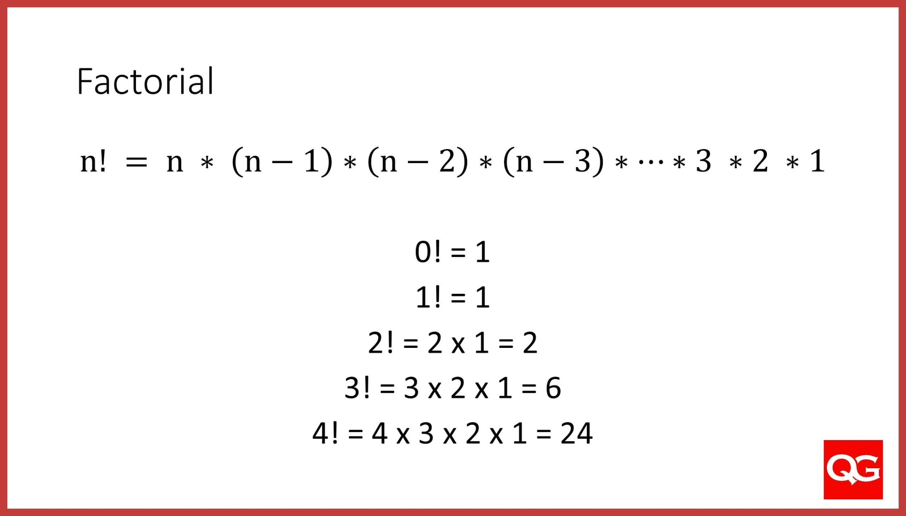
Exercise 5
Create a function that outputs n! (the product from 1 to n)

Slide 33
Future Areas of Exploration
Essential packages:
General: numpy, pandas
Data analysis: matplotlib, seaborn
AI/ML: scikit-learn, Tensorflow, PyTorch
Object-oriented programming

Slide 34
Future Areas of Exploration
Essential packages:
General: numpy, pandas
Data analysis: matplotlib, seaborn
AI/ML: scikit-learn, Tensorflow, PyTorch
Object-oriented programming

Slide 35
UCLA Courses
Some Introduction to Python Courses at UCLA:
STATS 21
PIC 16A
PIC 16B

Slide 36
References
Professor Miles Chen Stats 21 course lectures
https://github.com/Asabeneh/30-Days-Of-Python
I stole all the memes from the internet via google search somewhere
You get a free candy if you can find the google searches leading to the exact memes

